Slide 1
Scheduling and Student Performance
Clifford A. Shaffer and Stephen H. Edwards
Department of Computer Science
Virginia Tech

Slide 2
Student Project Scheduling
Managing large-scale projects involves significant efforts to plan and schedule activities
It is human nature to work better toward intermediate milestones.
The same concepts can/should be applied to mid-sized projects encountered in class.
Students need training in this practice if we expect them to do it
For any project that needs more than a week of active work to complete, break into parts and design a schedule with milestones and deliverables

Slide 3
Study
CS2606 Data Structures and Algorithms, Fall 2006
3-4 week projects (four during semester)
Kept schedule information:
Estimated time required
Milestones, estimated times for each
Weekly estimates of time spent.

Slide 4
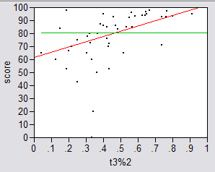
Results
Amount Done 1 Week Prior to Due Date

Slide 5
Interpretation
Results were significant:
90% of scores below median involved students who did less than 50% of the project prior to the last week.
Few did poorly who put in > 50% time early
Some did well who didn’t put in >50% time early, but most who did well put in the early time
Correlations:
Strong correlation between early time and high score
No correlation between time spent and score
No correlation between % early and total time

Slide 6
Correlation vs. Causation
Do successful students behave that way because they are “good students”, or does behaving that way make them good?
Test causation with Web-CAT data
Over 5 years, compare students who got A/B on one project, and C/D/F on another to see effect of early progress.
Again, we found a significant difference.

Slide 7
What is the Mechanism?
Spreading projects over time allows the “sleep on it” heuristic to operate
Avoiding the “zombie debugger” effect makes people more productive (and cuts time spent)

