Slide 1
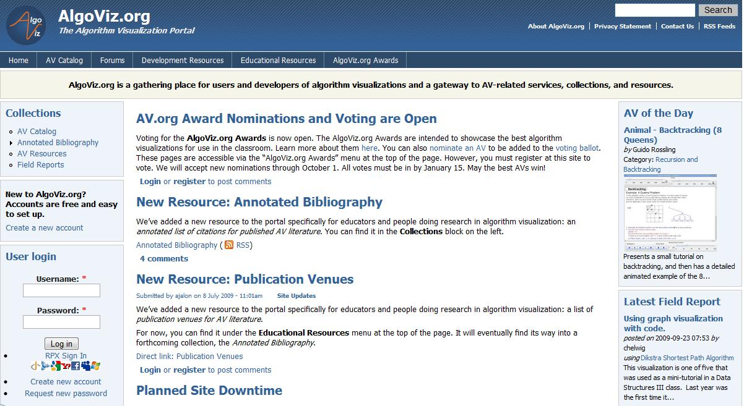
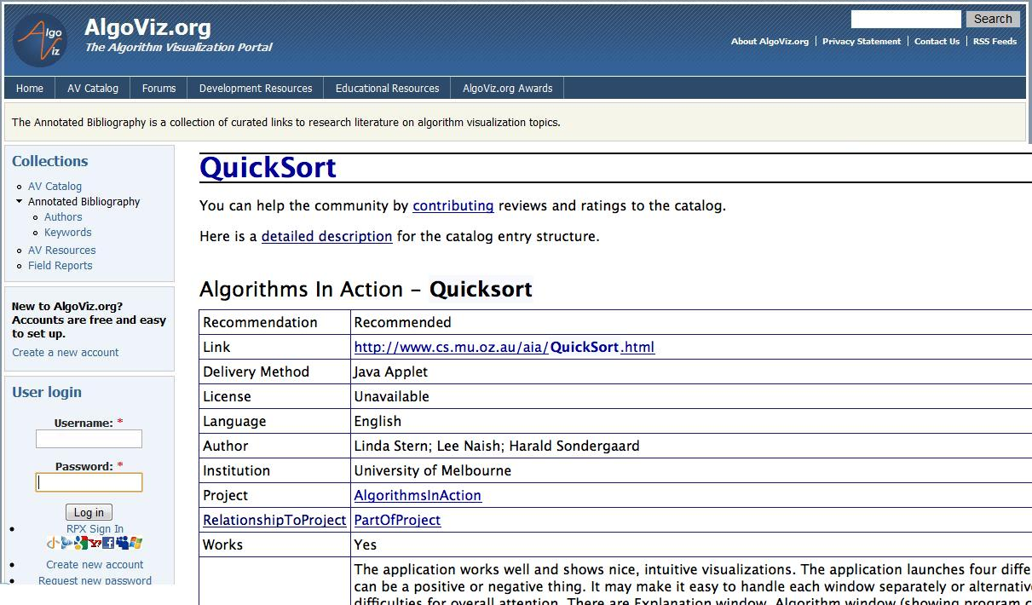
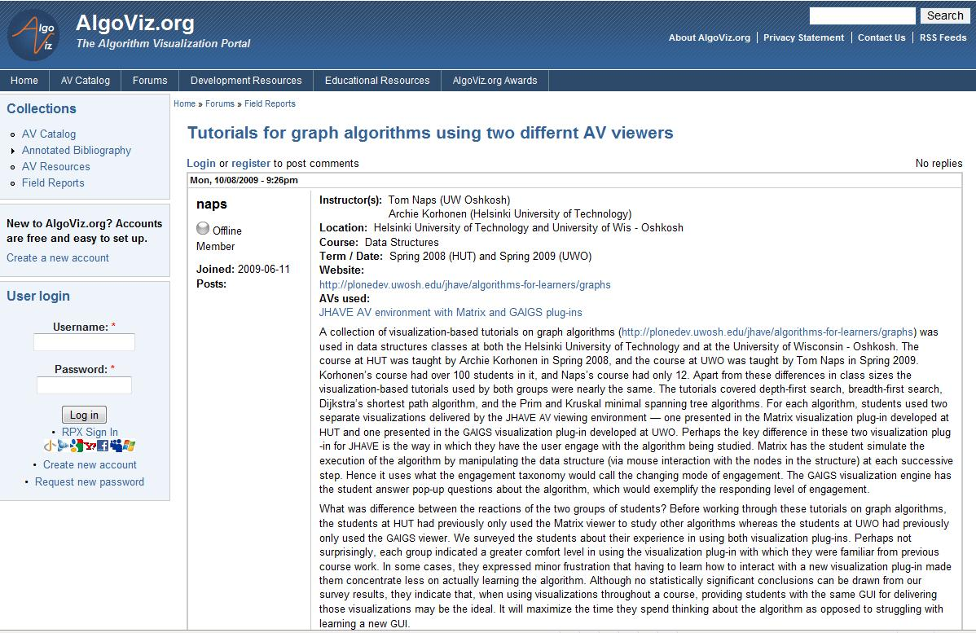
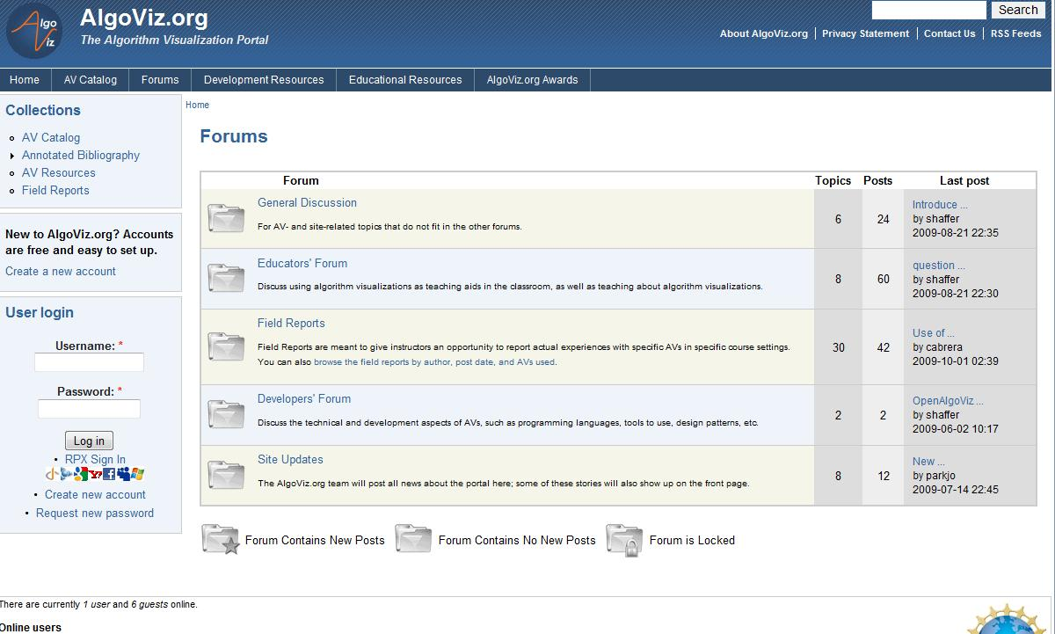
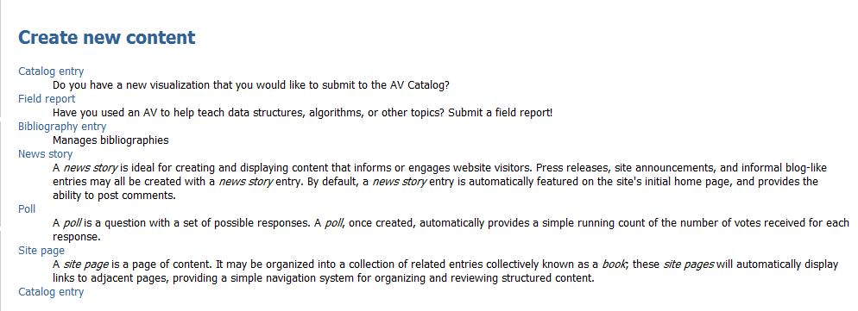
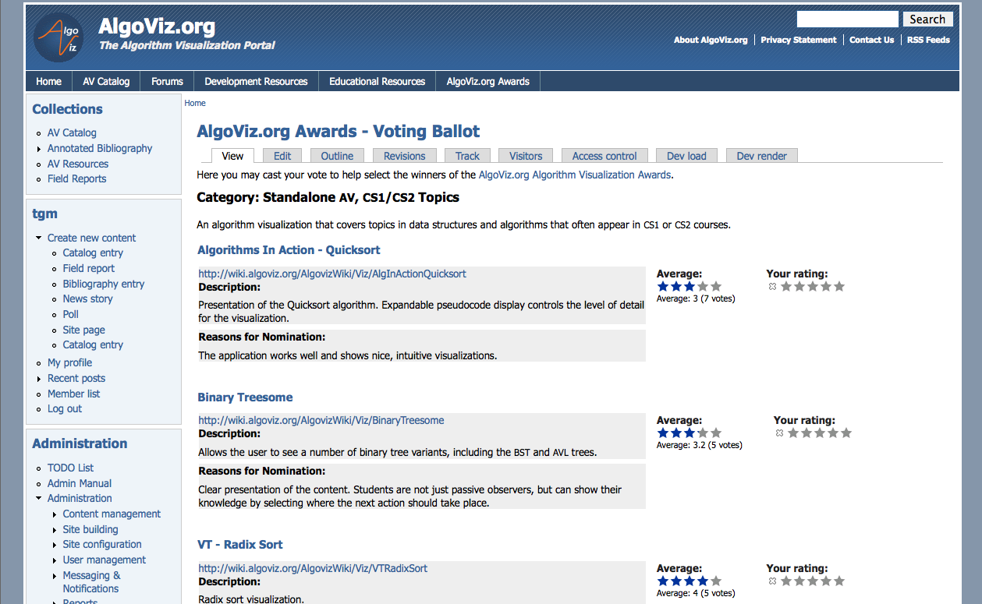
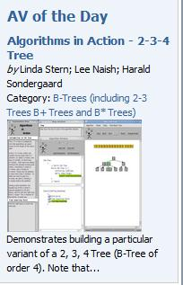
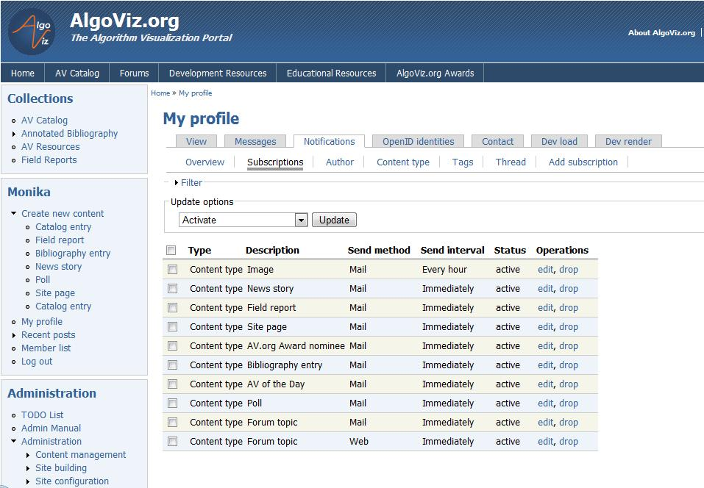
The AlgoViz Portal
Lowering the Barriers for Entry into an Online Educational Community
Monika Akbar, Alexander Joel Alon, Michael Stewart, Clifford A. Shaffer, Stephen H. Edwards. Department of Computer Science, Virginia Tech.
Email: {amonika, alon, tgm, shaffer, steve.edwards}@vt.edu
Algorithm Visualization (AV)
AVs are used for motivating students in exploring the core concepts of data structure and algorithms.
Instructors report difficulty in finding and using quality AVs
AlgoViz Portal provides:
an extensive AV Catalog with detailed descriptions and evaluations
A community of users: instructors, students, developers, researchers
Developing Collections and Content
Educators : Forum for sharing and learning from each others’ experience
Catalog of over five hundred AVs
Browse by category
Full text search
Ratings and comments
Field reports
Discussion boards
AV Developers: Platform for creating better AVs
Developer resources
OpenAlgoViz, a SourceForge site for example implementation and open source code of AVs
AV Researchers: Gateway for AV-related services, collections, and resources.
Other AV repositories
Publication venues
Annotated bibliography
Supporting Online Community
Ease of Access – Minimize the difficulty of getting started.
Ease of content creation – Drupal CMS allows easy content creation for each registered user.
Ease of contribution – Registered users can easily create new content, rate existing content, contribute forum posts or leave feedback and comments.
Ease of staying informed – Registered users get notification of site and forum updates through email or Twitter
Ease of communication – Forums, field reports, email
http://algoviz.org
Encouraging User Participation
AlgoViz.org Awards - A process for honoring outstanding AVs. The AVs were nominated and voted on by community members. Winners will be announced at SIGCSE 2010.
AV of the day – Showcases high quality AVs in the front page.
Future work
Rewards for participation
Suggestion of content based on user behavior.
Showing navigation trends on the site.
NSF Grant: DUE-0836940

