Slide 1
Towards a Concept Inventory for Algorithm Analysis Topics
Mohammed Farghally
Information Systems Department, Assiut University, Egypt
Kyu Han Koh
Department of Computer Science, CSU Stanislaus
Jeremy V. Ernst
School of Education, Virginia Tech
Clifford A. Shaffer
Department of Computer Science, Virginia Tech
Friday, March10, 2017
SIGGCSE 2017 Seattle WA

Slide 2
Agenda
The Algorithm Analysis Concept Inventory (AACI)
Defining the Scope
Identifying Misconceptions
Pilot AACI item Design
AACI Validity and Reliability
Item Analysis
Conclusions

Slide 3
The Algorithm Analysis Concept Inventory
To support evaluation of AAV: a standardized instrument to measure student performance.
A Concept Inventory for algorithm analysis can serve as the AA part of the final exam.
CI

Slide 4
The Algorithm Analysis Concept Inventory (2)
Defining the scope
Start with an initial list of concepts
Identifying misconceptions
Developing Questions
By consulting experts, a final list of concepts is composed
Experts are consulted for validation
Delphi process
Pilot AACI items were created.
Initial list
List is validated through student responses
Based on fundamental concepts and misconceptions.
Validity and reliability
Face Validity through Delphi experts
Student Content Validity
Single administration reliability measures (Cronbach’s alpha)
Item Response Theory
(ICC and TIF)

Slide 5
Defining the Scope
Started with an initial list of 21 concepts.
10 experts were consulted through a Delphi process.
Delphi process : a structured process for collecting information and reaching consensus among a group of experts
Experts are anonymous (to each other)

Slide 6
Phase1 : Initial Rating
1- Initial list of concepts
2- Concept ratings (Importance, Difficulty) + New Concepts
3- Medians and IQRs
Phase2 : Negotiation
4- Calculated medians and IQRs for each concept
5- Concept ratings (Importance, Difficulty)
6- Rating justification if outside IQR
7- Medians and IQRs
Phase3 : Final Rating
8- Calculated medians and IQRs for each concept
9- Anonymous rating justifications
10- Concept ratings (Importance, Difficulty)
11- Medians and IQRs
Experts
Researchers

Slide 7
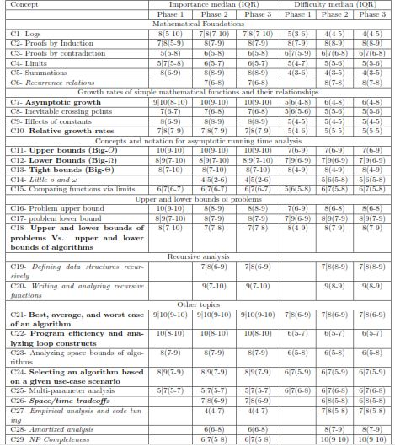

Slide 8
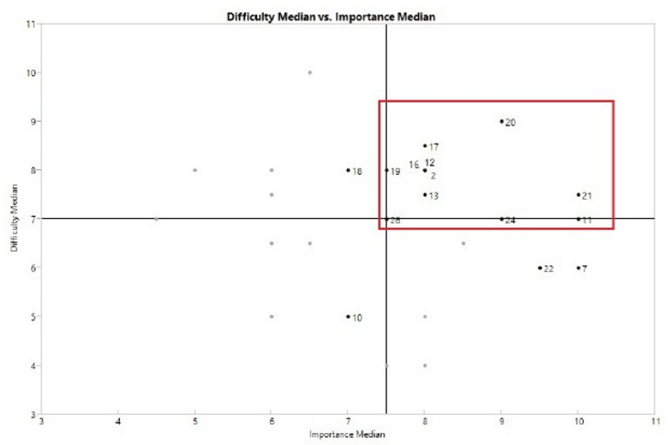
Region Of Interest (ROI)

Slide 9
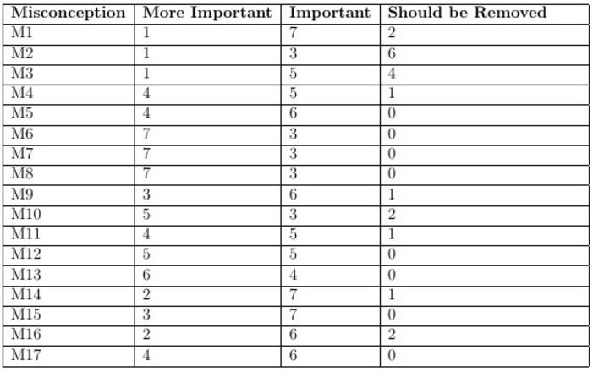
Identifying Misconceptions
Started with an initial list of 17 misconceptions.
Experience and Literature
Post-test at Fall 2014
Validated by our Delphi experts.

Slide 10
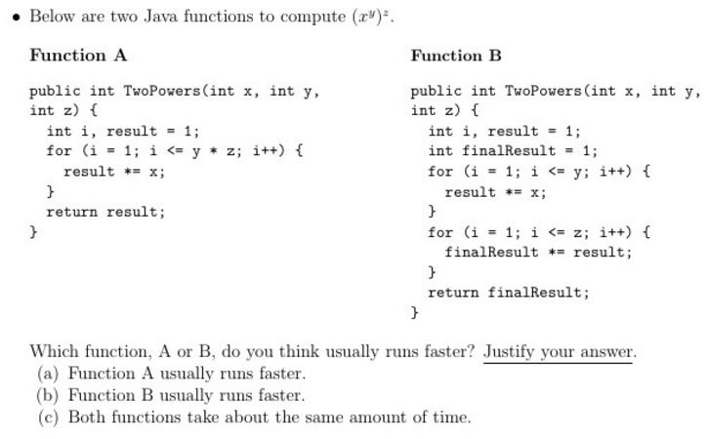
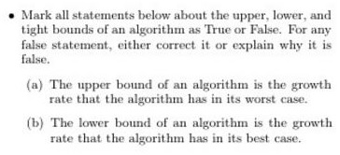
Pilot AACI Item Design
A set of 10 items were developed.
Some contains sub-items for a total of 29 items.
MCQ, TF, and open-ended questions.
Covering all important and difficult concepts.
Probing student misconceptions.

Slide 11
AACI Validity and Reliability
To be widely accepted, a CI should be both valid and reliable.
A CI validation test answers
“Are we measuring what we think we are measuring?”
“Have we covered the required concepts?”
A CI reliability test answers
“Do test items give appropriately consistent results?”

Slide 12
AACI Validity and Reliability
The pilot AACI was administered 4 times
Virginia Tech during Fall 2015 (N = 67) and Spring 2016 (N = 155).
Christopher Newport during Fall 2015 (N = 40) and Spring 2016 (N = 32).

Slide 13
AACI Reliability
Single administration reliability measure (Internal Consistency).
Cronbach’s-alpha Coefficient
The pilot AACI has α = 0.82 (Good) (Nunnally, J. C. 1978).

Slide 14
AACI Validity
Expert Content Validity (Face Validity).
For all items, at least 80% of the experts rated it as good.
Otherwise, some rewording was suggested.

Slide 15
AACI Validity (2)
Student Content Validity.

Slide 16
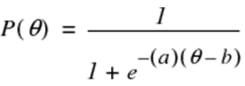
Item Analysis
Provides information about the usefulness of a test item and how it relates to other items in the test.
Item Response Theory (IRT)
Item Characteristic Curves (ICC)
Test Information function (TIF)
Two parameter logistic model

Slide 17
Item Analysis (2)
Difficulty: 0.51 (Moderate)
Difficulty: -1.54 (Easy)
Discrimination: 1.39 (High)
Discrimination: 1.30 (Moderate)
Difficulty: -0.17 (Moderate)
Difficulty: -0.84 (Moderate)
Discrimination: 8.62 (Very High)
Discrimination: 2.74 (Very High)
Baker, Frank B. The basics of item response theory. For full text: http://ericae. net/irt/baker., 2001.
Notes:
Discrimination is the slope of the ICC at its inflection point.

Slide 18
Item Analysis (3)
Difficulty: -1.31 (Easy)
Difficulty: -0.79 (Moderate)
Discrimination: 0.62 (Low)
Discrimination: 0.49 (Low)
Difficulty: -6.72 (Very Easy)
Difficulty: 1.05 (Above Average)
Discrimination: 0.20 (Very Low)
Discrimination: -0.17 (Very Low)

Slide 19
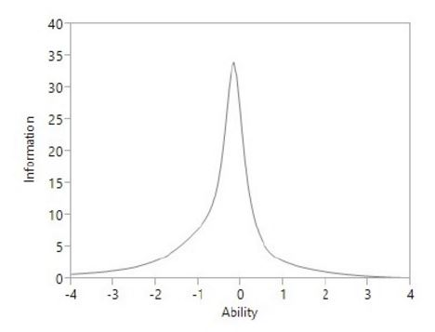
Item Analysis (4)

Slide 20
Conclusions
The pilot AACI did a good job in detecting the identified student misconceptions.
Most of the items are good according to expert feedback and IRT analysis.
It is a Valid and Reliable measure of student knowledge of Algorithm Analysis.

Slide 21
Future Work
Alpha AACI
Improve items. (Get more feedback from instructors.)
More administrations. (Get more performance feedback.)
Conduct student interviews. (Get more feedback from students.)
Thank you! To NSF funding under grants DUE-1139861, IIS-1258471, and DUE-1432008.

